Slide 1

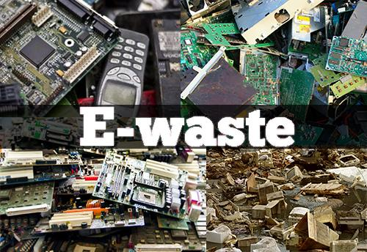
EWARDD
Welcomes you to Presentation On
E-Waste Management
Presented By-
Asif Pasha, MD ,
EWaRDD Recyclers
Ct-91 9880884166
asifpasha95@gmail.com
info@ewardd.com

Slide 2
Contents
About E-WarDD
What is E-Waste
Harmful Effects of Electronic Waste
E-Waste Data Worldwide & India
Govt . Mandates towards E-waste
How E-WaRDD Can Help Your Organization Achieve EPR Targets
Certifications
Collaborations
Milestones
Unit Process Operations and Machinery
Process Flow
Precious Metals Recovery
Pollution Control Measures
OH&S
Contact Us

Slide 3
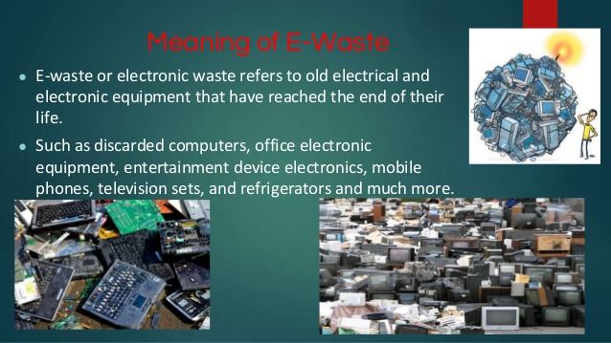
What is E-Waste
Electronic waste is a common, informal name for electronic products approaching the end of their useful life.
E-wastes are considered dangerous, as certain components of some electronic products contain materials that are harmful, depending on their condition and density.
The harmful content of these materials poses a threat to human health and environment.

Slide 4
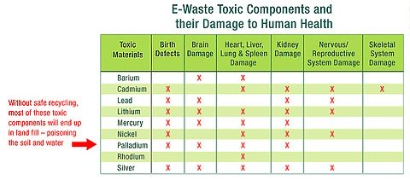
Harmful Effects of E-Waste
Lead- Presence of lead in electronic wastes such as television, PC monitors, and LEDs can cause serious diseases related to brain, kidney, reproductive system and entire nervous system. Specifically speaking, lead in the environment disrupts the natural functions of water and soil systems.
Mercury- Mercury has a toxic affect on both human and environment health. A small amount of it exists in CFLs, televisions and in refrigeration units. When the said e-waste is dumped into the landfills and water bodies the elemental form of mercury gets easily transferred into local environments.
Cadmium- Cadmium causes cancer to humans and when comes in contact with the environment, it rapidly degrades the health of the soil causing flow of effects to local ecosystems. When the electronic waste containing cadmium burns, it releases a lethal gas which on prolonged exposure causes lung failure.
E-waste also contains toxic and hazardous materials including mercury, lead, cadmium, beryllium, chromium, and chemical flame retardants, which have the potential to leach into our soil and water.

Slide 5
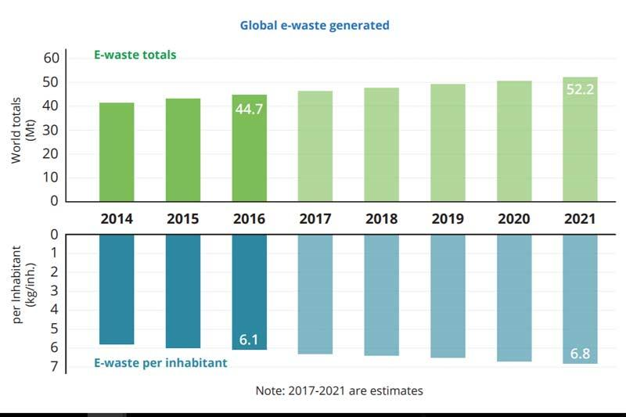
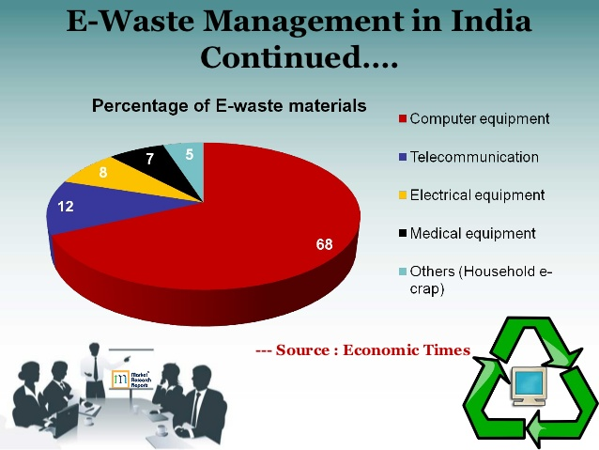
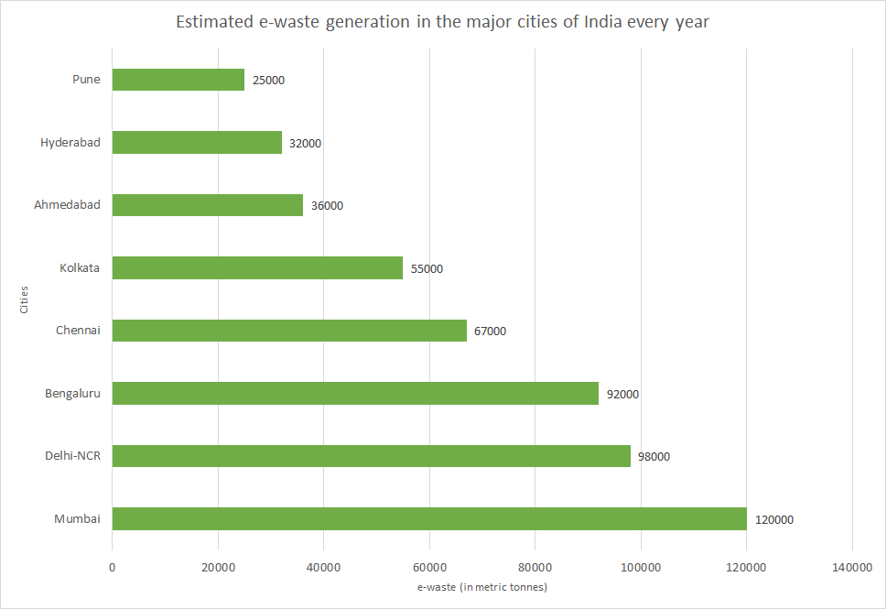
E-waste Data – Worldwide and India
According to the Global E-Waste Monitor 2017, released by ITU, the UN University (UNU) and the International Solid Waste Association (ISWA)
In Year 2016, 44.7 million metric tonnes of E-Waste were generated, an increase of 3.3 million tonnes, or 8%, from 2014. In 2016, only 20 per cent, or 8.9 million metric tonnes, of all E-Waste was recycled
Experts foresee E-Waste increasing a further17%, to 52.2 million metric tonnes by 2021.

Slide 6
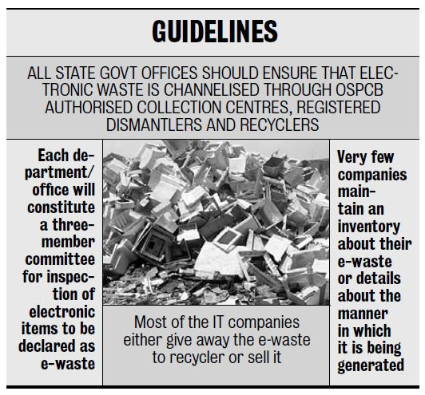
Govt Approach & Policies towards E-Waste
As per the new E-Waste (Management) Rules 2016, it has become mandatory for bulk consumers, producers and manufacturers of all electrical and electronic equipment to bide by their EPR. These rules clearly indicate that a target is set for a bulk producer as per their market share to channelize their e-waste for responsible recycling.
What is EPR?
Extended Producer Responsibility (EPR) means responsibility of any producer of electrical or electronic equipment, for channelization of e-waste to ensure environmentally sound management of such waste. Extended Producer Responsibility may comprise of implementing take back system or setting up of collection centres or both and having agreed arrangements with authorised dismantler or recycler either individually or collectively through a Producer Responsibility Organisation recognised by producer or producers.
What is the role of a PRO?
A Producer Responsibility Organisation is an organisation that helps producers meet their EPR targets through various recyclers and dismantlers in the country. PRO is responsible for setting up a collection mechanism for the targeted material and create awareness for recycling of e-waste.

Slide 7
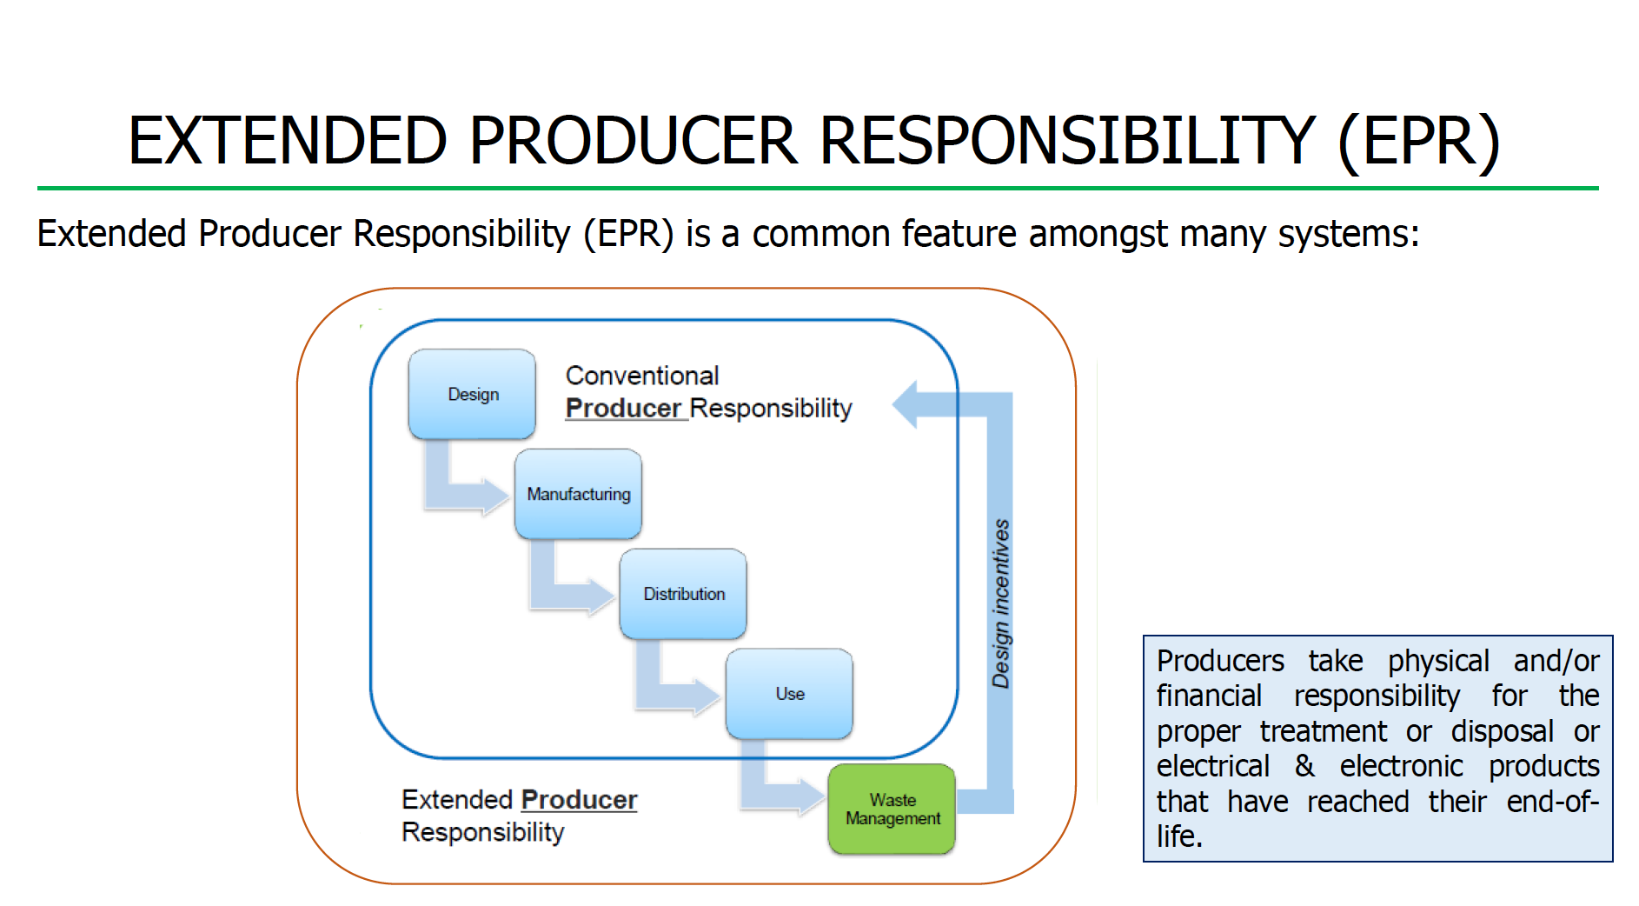
How E-WaRDD can help you Achieve EPR Targets
As Your Extended EPR Arm, We will ensure transparency in operations, commitment & responsibility towards meeting your EPR targets in a specified timeframe, Guidelines and strong Work Ethics.
We specialize in reverse supply chain services -reverse logistics, environmental reporting & downstream processing.
Presence across India through our collection centres & channel partners, in our ISO Certified and R2 Certified (in process), excellent facility in Bangalore.
We provide evidences in the form of videos, pictures, documents etc as per the requirement of the producer.

Slide 8
About E-WaRDD
Objectives
Focusing on providing solution for E- Waste Management, Waste disposal, Re-use and Waste recycling. Reducing waste to landfill in an environmental friendly manner.
Committed to the ZERO negative environmental impact through best indigenous Indian Solution for the collection, transportation, segregation and recycling of end-of-life electronics
Our Facilities
Estd in Year 2006 in Bangalore
Size of the unit: 5400 sq.ft & located in Industrial area of Nyandanahalli, Mysore Road.
Number of employees: 20
Modern Equipment with Installed Capacity – 2 Tonnes per day
CPCB and KSPCB Authorized Recycler’s.
Our Facilities PAN India (with Channel partners)
Bengaluru New Delhi Mumbai Hyderabad
Kerala Kolkata Chennai Pune
Notes:
1. History, chronology What it is about
2. Unit it self

Slide 9
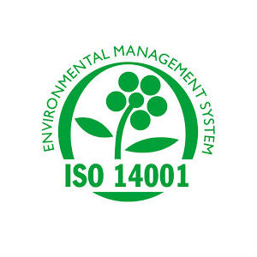

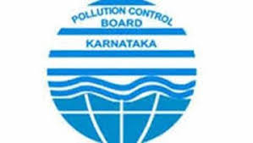
Certifications
We are ISO 14001:2004 and ISO 9001:2008 Certified E-Waste Organization
Approved & Authorised by KSPCB

Slide 10


Collaborations
E-WaRDD has active collaboration with the German Technical Corporation (GTZ) and the Swiss Federal Laboratories for Materials Testing and Research (EMPA).
E-WaRDD Team have received two years of intensive training from their Collaborators, in testing and upgrading e-waste and identifying and handling hazardous substances.

Slide 11
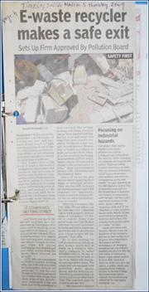
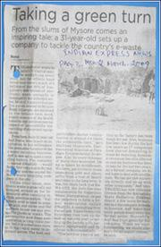
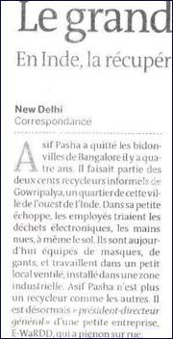
Media
“Asif Pasha could be the first person to convert from the informal recycling sector to the formal sector in India, and perhaps in the world, too.” – Times of India (5 Mar 2009).

Slide 12
Milestones
2006
Outlining of a business plan with GTZ ( German Collaborator)
Beginning of the training with GTZ and EMPA
2007
Relocated to a bigger setup in a Industrial area in Bangalore
KSPCB Authorization
2008
Purchase of Modern Pollution Control & OHS Equipment
2009
CPCB authorization
2018
ISO Certified
Application and Process for R2 Recycler Certification

Slide 13
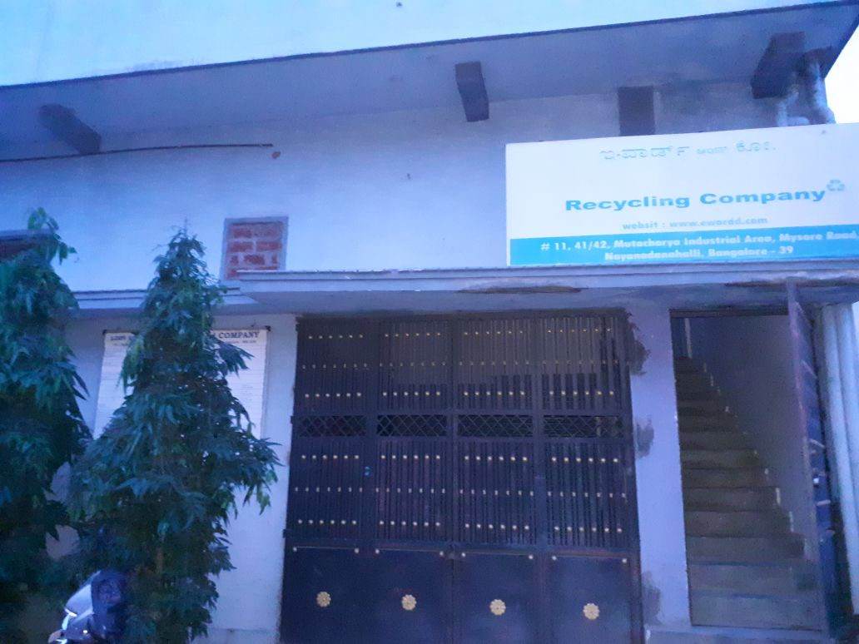
Location
Industrial area of Nyandanahalli , Mysore Rd, B’ lore

Slide 14





Our Services
Recycling
Data Destruction
Reverse Logistics
PRO Service for EPR Implementation
Recycling Certification as per CPCB guidelines

Slide 15
Processes
Collection and Storage
Segregation
Functional Testing
Dismantling
Scrap Recovery
Precious Metals Recovery
TSDF (Treatment, Storage & Disposal Facility)

Slide 16
Process Flow
Collection of
e-waste
Segregation and storage
Metal scrap
Sale to metal recycler
Plastic scrap
Sale to plastic recycler
Eventual add of components
Eventual refurbishment
Examination of refurbishment or reuse possibilities
Batteries
Sale to authorized battery recyclers
Manufacture of new products
Sale to second hand market
Dismantling
CRT glass
Large e-waste recycler
PCB Boards of low and high quality
Sale to PCB smelters
Recovery of reusable components
Recovery of scrap
Non recyclable hazardous waste (e.g. backup tapes)
Storage until hazwaste landfill is operational (TSDF)
Notes:
TSDF = Transfer Storage Disposal Facilities

Slide 17
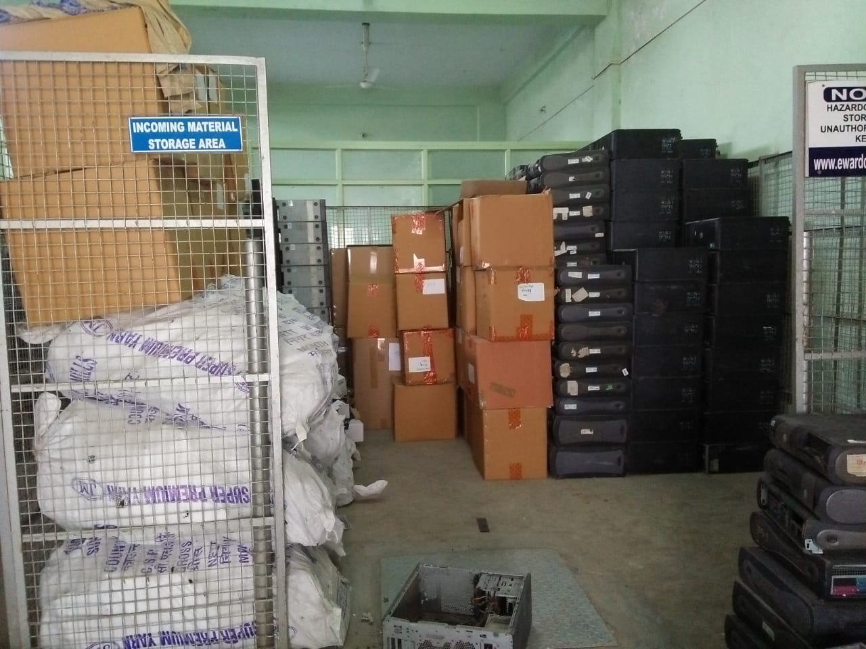
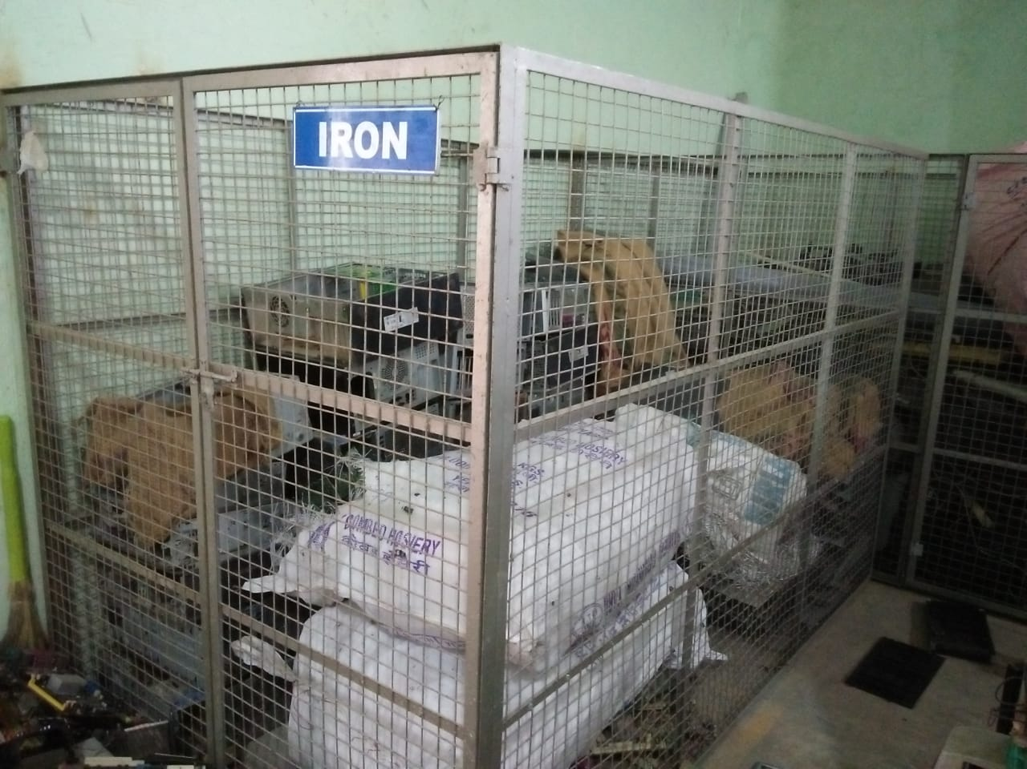
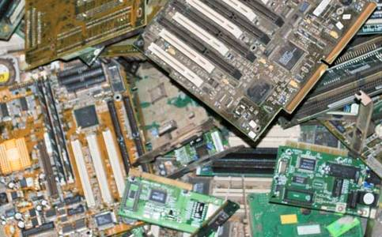
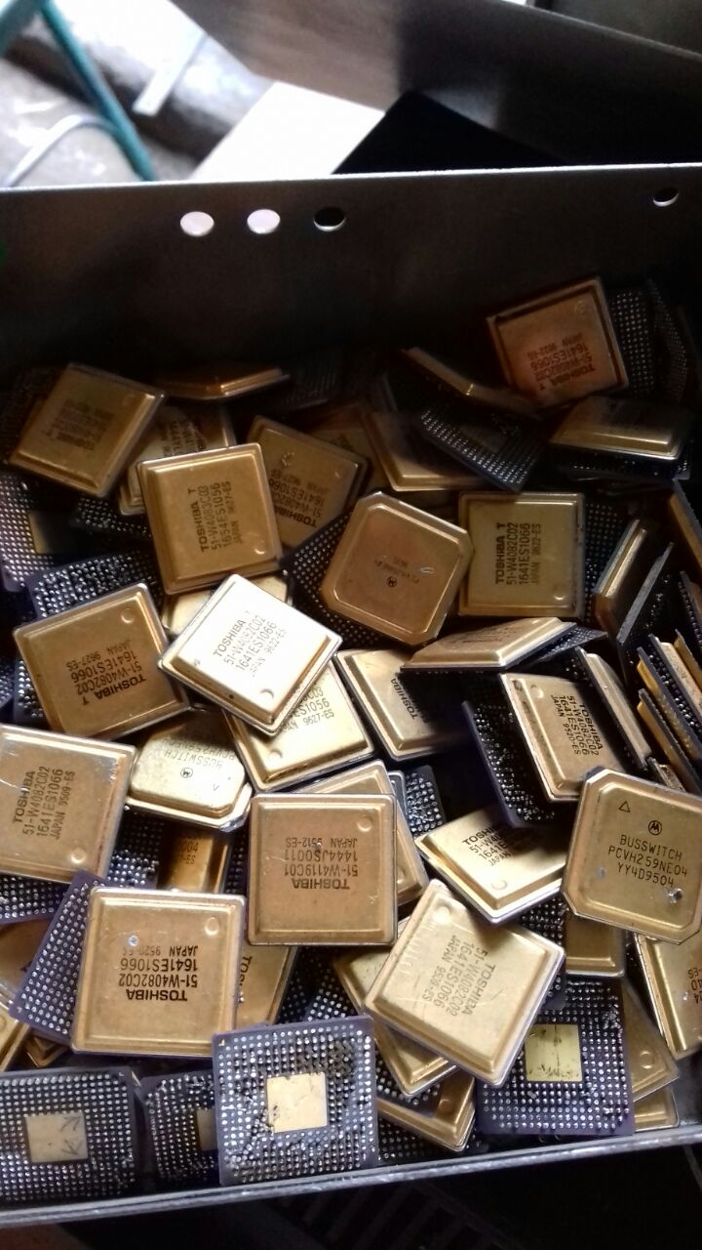
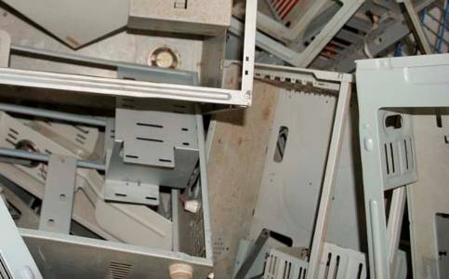
Process & Units- 1
Incoming Material
Segregation
Storage boxes For large size segregated material

Slide 18
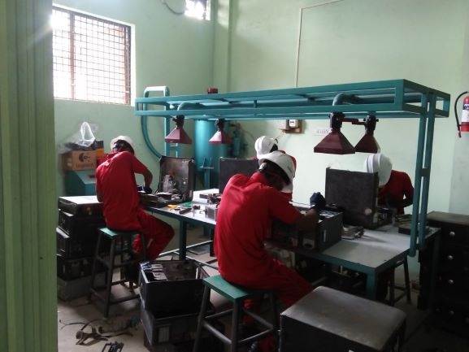
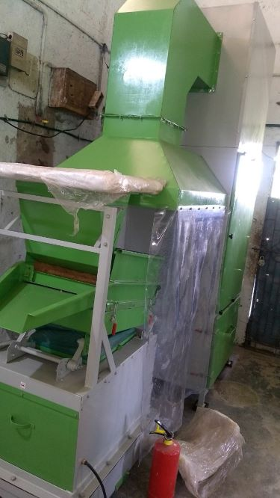
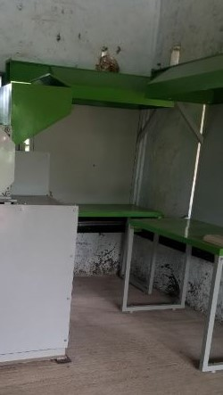
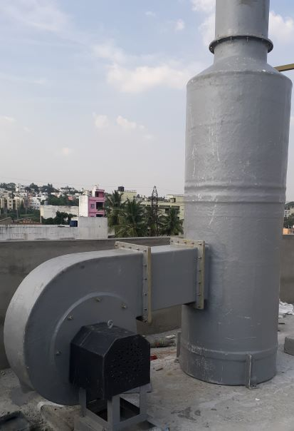
Machinery for Processes
Dismantling table with bag filter & Cyclone Machine
Copper Separator Machine from PCB
PCB Shredder Machine
Scrubber Air Filter System

Slide 19
INPUT
OUTPUT
Established Vendors & Authorized Smelters
Sources
Households, apartments, clubs Schools Scrap dealers and small companies Large scale companies Banks
Scrap | Destination
Metal scrap | Moogambigi Metal Trading Company Bannergatta Hamlet, Jigani, Hobali Anekal Taluk, Bangalore
Plastic scrap | Petroplast Industries No 19, K.H. Ranganatta Colony Mysore Road, Bangalore
Batteries | G.N. Industry Peeniya Dasarhali 2nd stage, Bangalore
Types of Wastes
Electronic devices Electrical devices IT and telecommunication Medical equipment
Scrap | Intended destination
CRT glass | Recycling Smelters
PCB boards | Umicore Broekstraat 31 rue du Marais B-1000 Brussels, Belgium
Non-Recyclable hazardous Waste | TSDF Dabbespet, Nelamangala , Blr -Rural

Slide 20
Outflow of Air and Sewage
Type | Pollution control measures | Destination
Air | Cyclone and dust collector. Capacity : 2’000 KL/H | TSDF Dabbespet, Nelamangala Tq, Bangalore rural
Water | No Treatment | Decentralized Waste Water Treatment

Slide 21
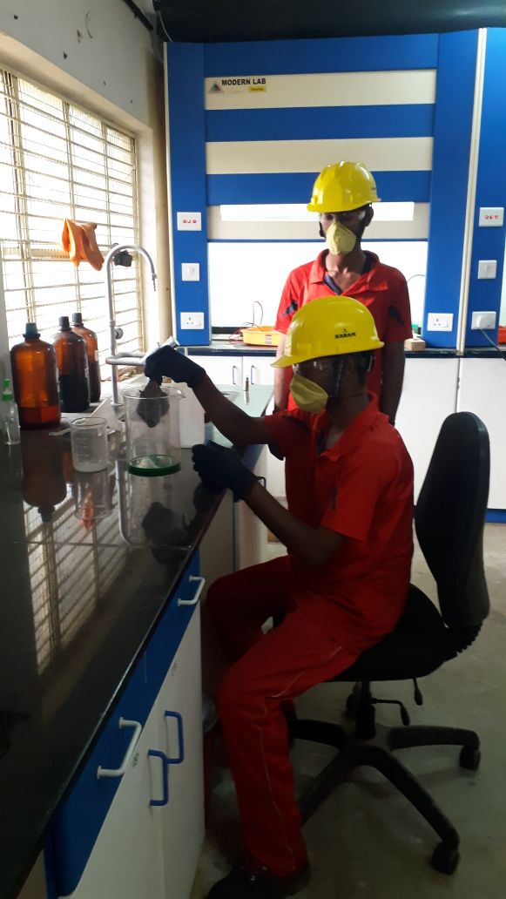
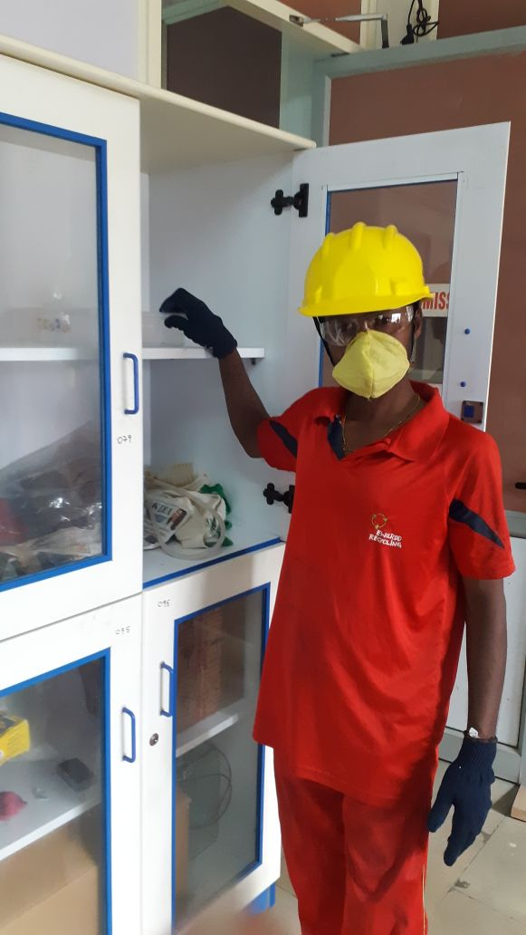
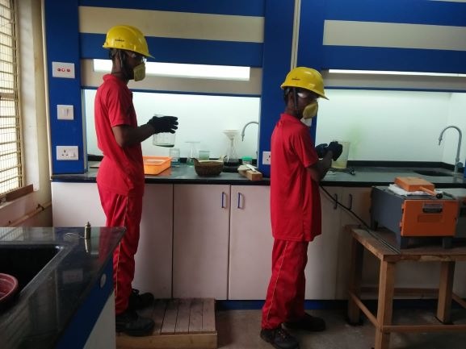
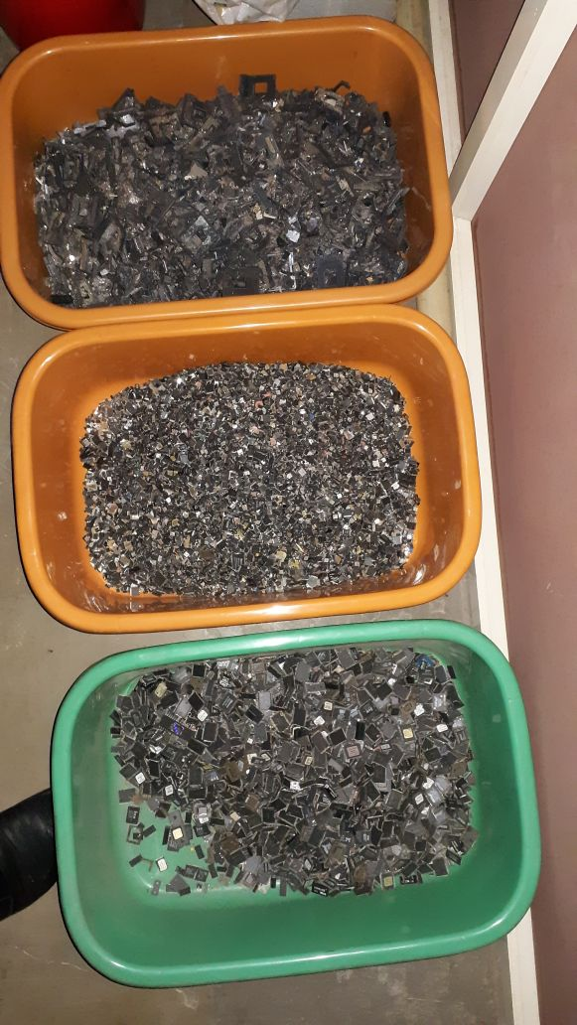
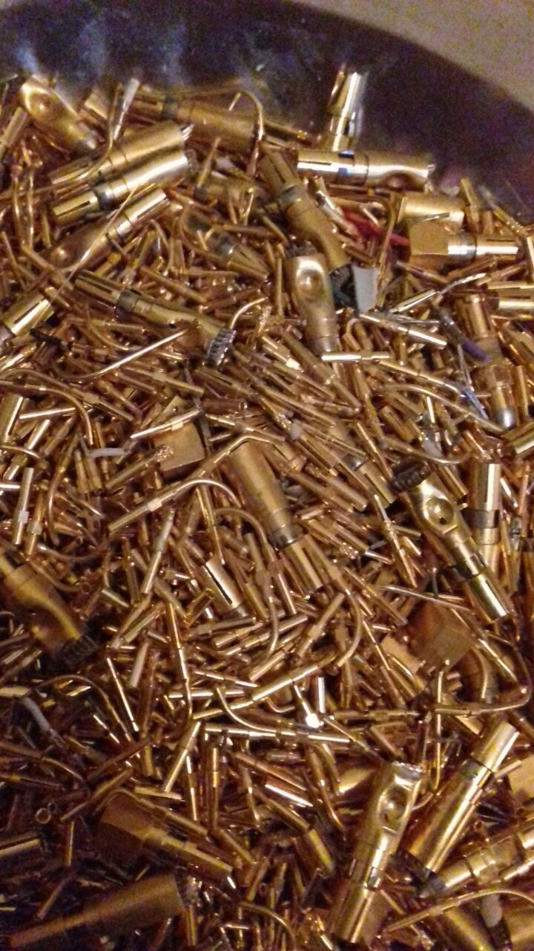
Precious Metal Recovery Lab with Fume Cupboards

Slide 22
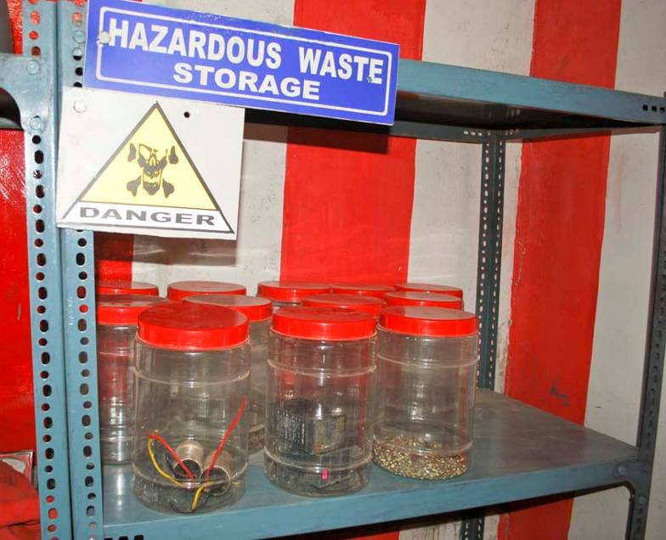
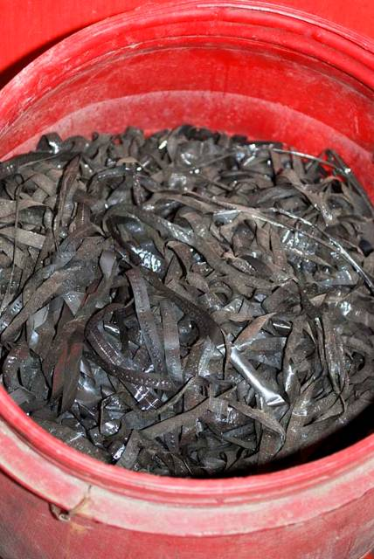
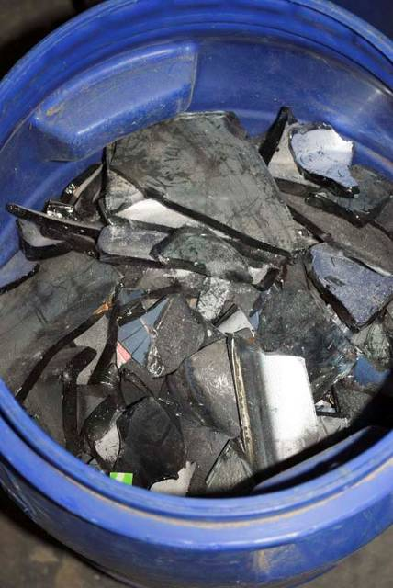
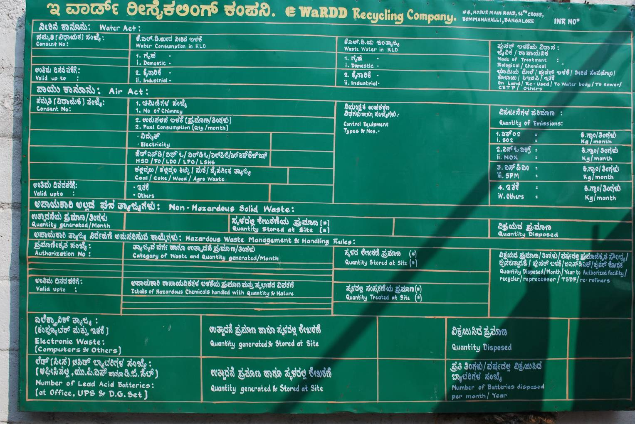
Storage of Hazardous Waste
Batteries, Condensators and Capacitors
Tapes
CRT glass
Monthly monitoring mechanism - Hazardous waste display board
Notes:
Power supplies
Ask what they do with the glass

Slide 23
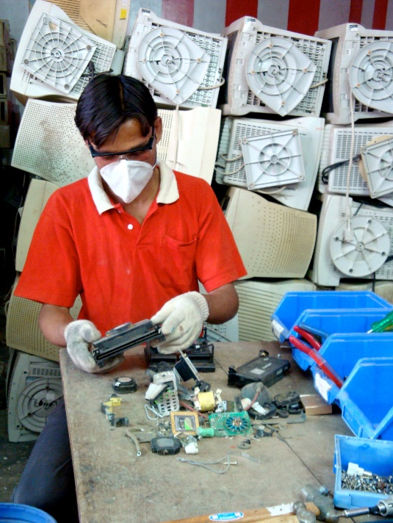
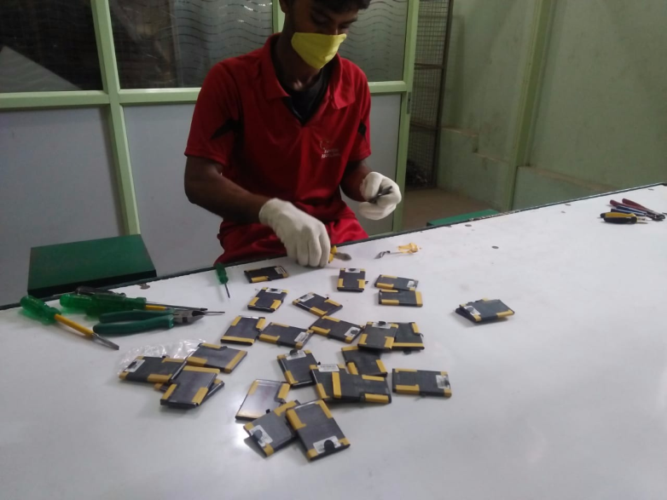
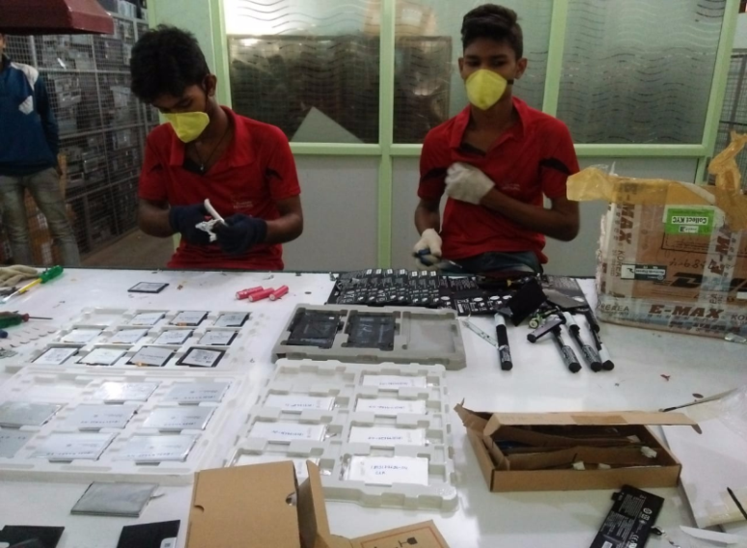
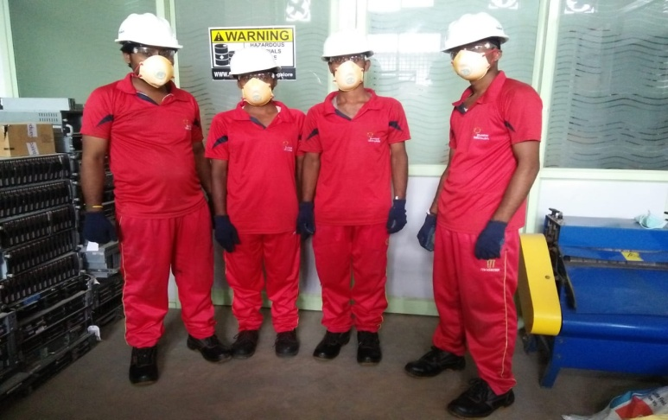
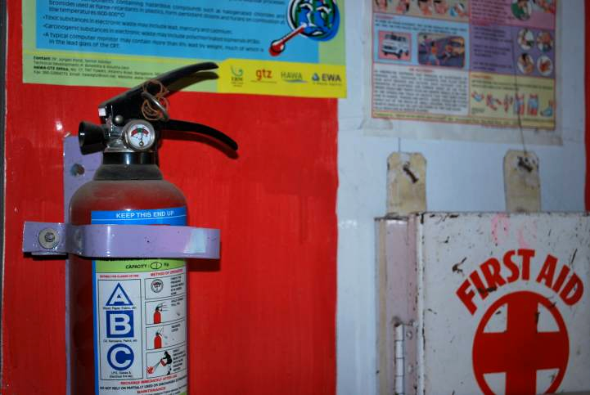
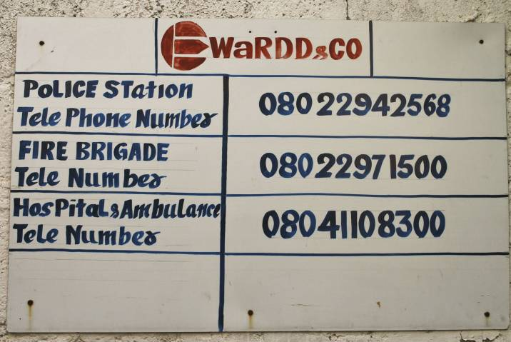
occupational Safety & Health Equipments For Employees
Protective Mask
Heavy duty hand gloves
Safety Boots
Protective Eye-glasses
Ear muffs
First Aid kit & Chart
Fire Extinguisher
Emergency Ct. Numbers

Slide 24












Our Major Clients

Slide 25


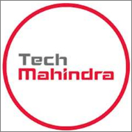


Slide 26
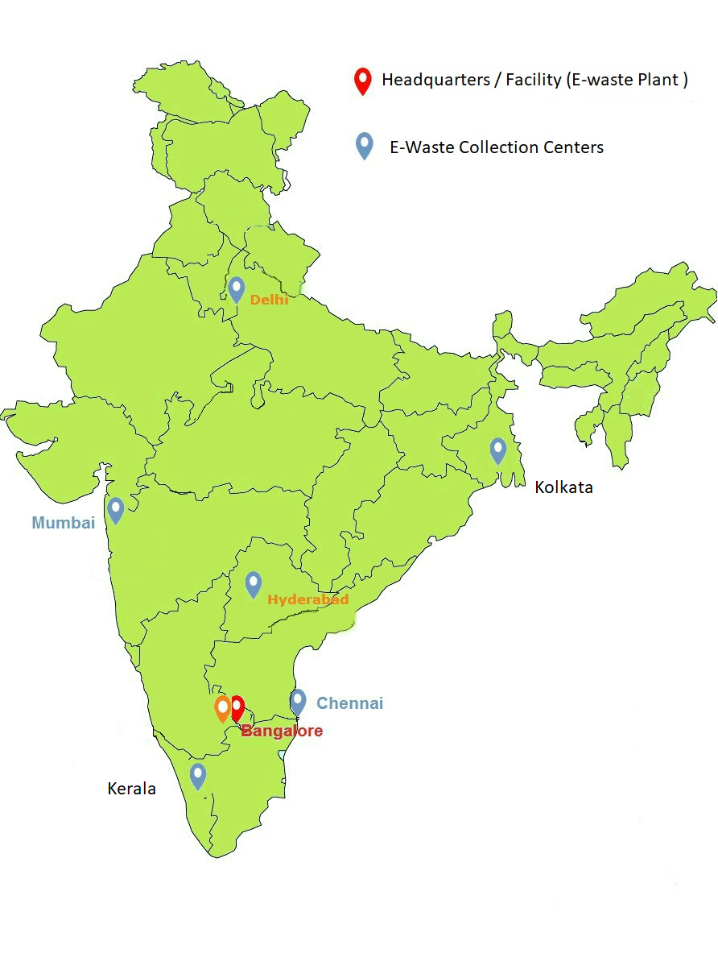
Contact Us
For more information visit our website www.ewardd.com
NAME | DESIGNATION | MOBILE NO | EMAIL ID
Asif Pasha | Founder & MD | 9880884166 | asifpasha95@gmail.com, info@ewardd.com
Macqueen Anthony | Procurement & Marketing | 7338649003 | mac.antho@ewardd.co.in
Nilesh Desai | Sales & Client Relationship | 7338649003 | n.desai@ewardd.co.in

